Slide 1
RECYCLING
And why it’s important

Slide 2
What is recycling?
Recycling is a way to dispose of your rubbish in a way that will make it easier to get rid of, or in some cases, to reuse it. It’s really important, especially nowadays with how polluted our environment is.

Slide 3
What does recycling help with?
Recycling helps us reduce the amount of things that end up in the ocean, in forests or in other parts of our environment. In the following slides I will show you how to recycle your trash properly.

Slide 4
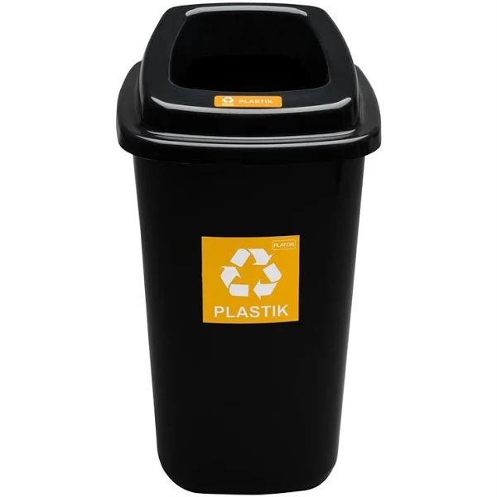
Trash in the yellow rubbish bins
The trash that you put in the yellow rubbish bins should only be plastic. There’s a lot of items made out of plastic, for example water bottles, packaging and plastic cutlery.

Slide 5
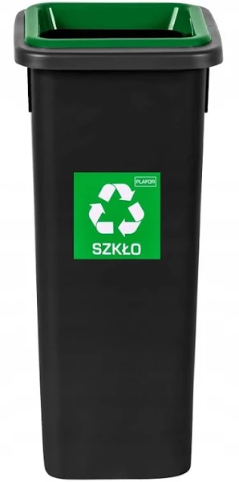
Trash in the green rubbish bins
Items that belong in the green rubbish bins are only things made out of glass, such as windows, cups and wine bottles.

Slide 6
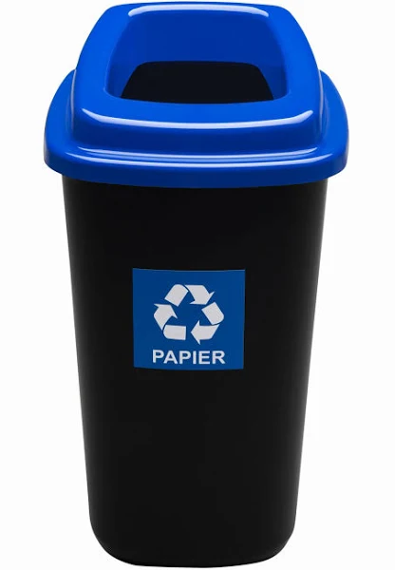
Trash in the blue rubbish bins
In blue rubbish bins you will find things that are made out of paper, like newspapers and cardboard boxes.

Slide 7
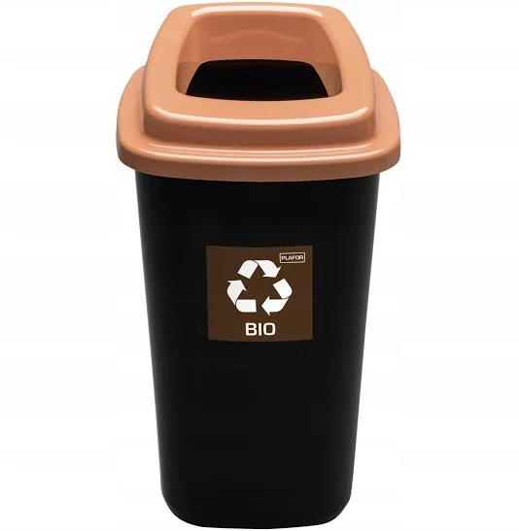
Trash in the brown rubbish bin
The trash that you will see in the brown rubbish bin is usually related to something you can grow, like potato peel or old vegetables/fruits.

Slide 8
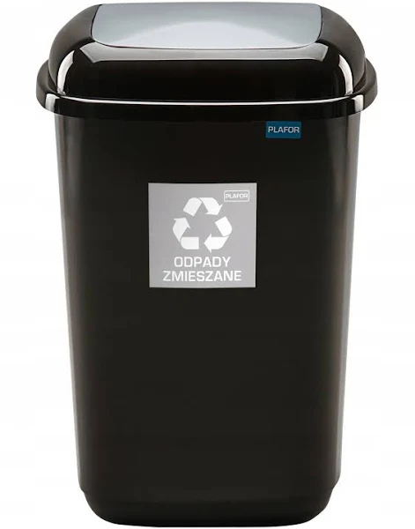
The trash in the black rubbish bins
The trash you should throw into the black bins can be anything that you can’t throw into the already mentioned rubbish bins.

Slide 9
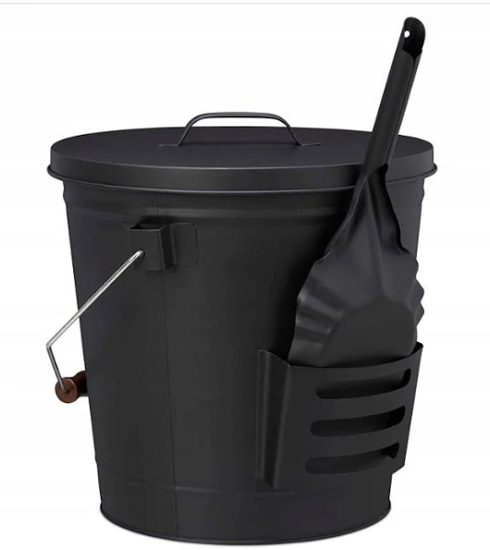
Ashes
A rubbish bin made specifically for ashes doesn’t exist, so If you have a fireplace it’s important to dispose of the ashes in a correct way.

Slide 10
Recycling is really important
Recycling saves our environment, and if you can, you should definitely recycle.

Slide 11
Thank you for your attention

Slide 12
Przygotowano w ramach promocji projektu Erasmus+ KA122 „Let’s get eco and get inclusive with our school”

